Slide 1
Long-Short Term Memory (LSTM)
Notes:
The dynamic state of NN is known as short-term memory and idea is to last short long time. This done through introducing a mechanism to gate the information. Top application: handwritten recognition.

Slide 2
The Problem of Long-Term Dependencies
Key Characteristic of RNNs
To connect previous information to the present task, e.g. previous video frames might help the understanding of the present frame
Drawback
RNN are useful to use the past information when the gap between the relevant information and the place that it’s needed is small, e.g. “the clouds are in the sky”
RNN is enable to handle applications that require longer context, e.g. “I grew up in Pakistan… I speak fluent Urdu.”
Why?
Vanishing gradient problem (VGP)
Notes:
e.g. the clouds are in the sky
I grew up in France… I speak fluent French

Slide 3
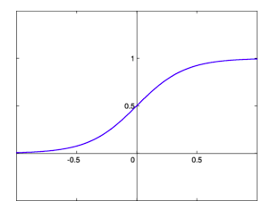

Vanishing Gradient Problem Intuition:

Slide 4

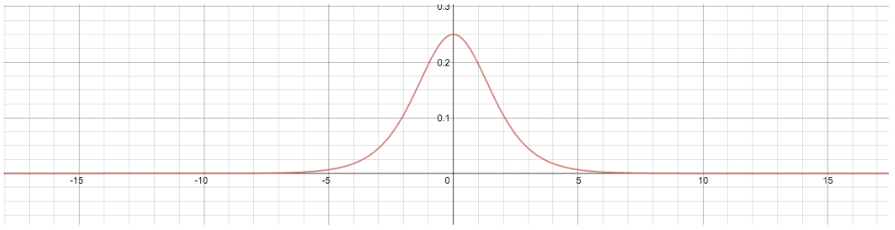
Vanishing Gradient Problem Intuition:
Derivative of Sigmoid function =
Value of derivative = (0-1/4)

Slide 5
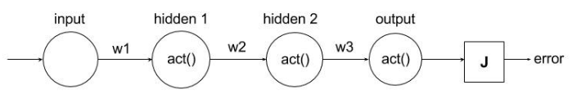

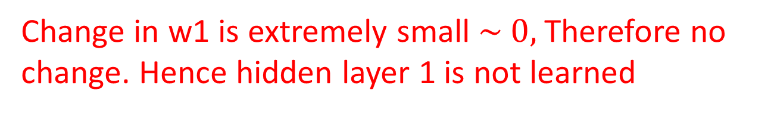
Neural Network and Backpropagation
< (1/4)
< (1/4)
< (1/4)
< (1/4)
Change in w1 is extremely small $\sim 0,$Therefore no change. Hence hidden layer 1 is not learned

Slide 6
Long Short Term Memory (LSTM)
Hochreiter & Schmidhuber (1997) solved the problem of getting an RNN to remember things for a long time (like hundreds of time steps).
They designed a memory cell using logistic and linear units with multiplicative interactions.
Information gets into the cell whenever its “write” gate is on.
The information stays in the cell so long as its “keep” gate is on.
Information can be read from the cell by turning on its “read” gate.

Slide 7
Basic Architecture of LSTM Unit
keep gate
To preserve information for a long time in the activities of an RNN, a memory cell is used.
The cell maintains its state by activating keep gate (i.e. by setting value of keep gate = 1).
Information is stored in the cell by activating its write gate.
Information is retrieved by activating the read gate.
The network learn values of gates by backpropagate error through these gates.
Gates are sigmoid (or logistic) functions, we can learn there weights
1.73
write gate
read gate
input from rest of RNN
output to rest of RNN

Slide 8
Intuition: Forward Propagation with One Unit
keep 0
keep 1
keep 1
keep 0
1.7
1.7
1.7
write 1
read
0
write 0
read
0
write 0
read
1
1.7
1.7
time →

Slide 9
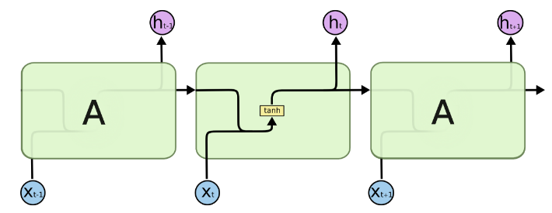
Understanding LSTM Architecture
Image is taken from http://colah.github.io/posts/2015-08-Understanding-LSTMs/
Repeated blocks in RNNs

Slide 10
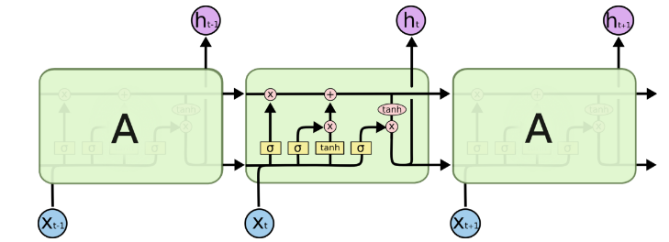

Understanding LSTM Architecture
Image is taken from http://colah.github.io/posts/2015-08-Understanding-LSTMs/
Repeated blocks in LSTMs
Notes:
Instead of having a single neural network layer, there are four, interacting in a very special way

Slide 11
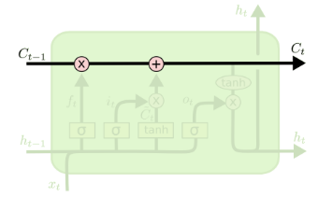
Understanding LSTM Architecture
Image is taken from http://colah.github.io/posts/2015-08-Understanding-LSTMs/
Cell state
A unit of LSTMs
Notes:
The key to LSTMs is the cell state, the horizontal line running through the top of the diagram.
The cell state is kind of like a conveyor belt. It runs straight down the entire chain, with only some minor linear interactions. It’s very easy for information to just flow along it unchanged

Slide 12
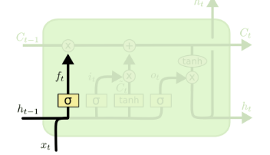

Understanding LSTM Architecture
Image is taken from http://colah.github.io/posts/2015-08-Understanding-LSTMs/

Slide 13
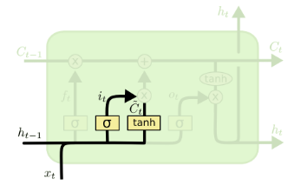

Understanding LSTM Architecture
Image is taken from http://colah.github.io/posts/2015-08-Understanding-LSTMs/

Slide 14
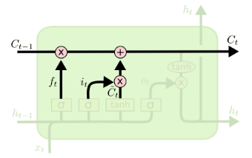

Understanding LSTM Architecture
Image is taken from http://colah.github.io/posts/2015-08-Understanding-LSTMs/

Slide 15
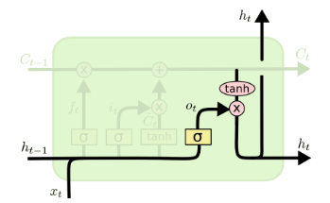

Understanding LSTM Architecture
Image is taken from http://colah.github.io/posts/2015-08-Understanding-LSTMs/

Slide 16
Recurrent Neural Network: Encoder Decoder Model
DNNs can only be applied to problems whose inputs and targets can be sensibly encoded with vectors of fixed dimensionality
It is a significant limitation, since many important problems are best expressed with sequences whose lengths are not known a-priori.
For example, speech recognition and machine translation are sequential problems. Likewise, question answering can also be seen as mapping a sequence of words representing the question to a

Slide 17
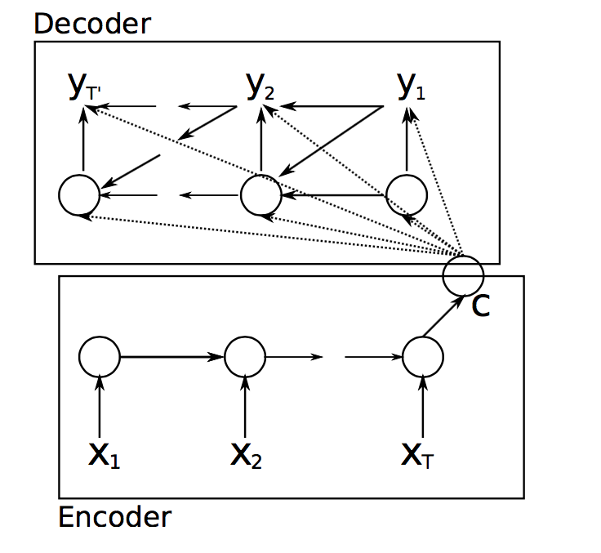
Recurrent Neural Network: Encoder Decoder Model
A key characteristic of RNNs is the ability to process variable size inputs and variable size outputs
This is achieved through encoder-decoder model
Encoder: Encode a variable-length sequence into a fixed-length vector representation
Decoder: Turn a fixed-length vector representation back into a variable-length sequence
Cho, Kyunghyun, et al. "Learning phrase representations using RNN encoder-decoder for statistical machine translation." arXiv preprint arXiv:1406.1078 (2014).

Slide 18
RNN Encoder-Decoder Based Neural Machine Translation
Encoder: Use RNN to encode a variable-length sequence into a fixed-length vector representation
Decoder: Use another RNN to turn a fixed-length vector representation back into a variable-length sequence
Cho, Kyunghyun, et al. "Learning phrase representations using RNN encoder-decoder for statistical machine translation." arXiv preprint arXiv:1406.1078 (2014).

Slide 19
RNN Encoder-Decoder Based Neural Machine Translation
Issue:
Gradient vanishing and exploding problem
Simple RNN is inefficient because it is enable to learn longer sequences
Solution:
To use LSTM instead of simple RNNs (next slide)
Cho, Kyunghyun, et al. "Learning phrase representations using RNN encoder-decoder for statistical machine translation." arXiv preprint arXiv:1406.1078 (2014).

Slide 20
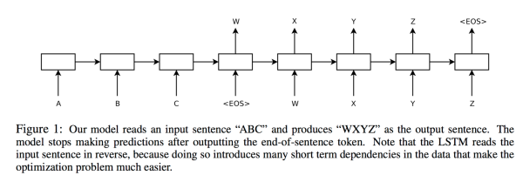
LSTM Encoder-Decoder Based Neural Machine Translation
Key Idea:
Encoder: Use LSTM to read the input sequence, one time step at a time, to obtain large fixed dimensional vector representation
Decoder: Use another LSTM to extract the output sequence from that vector
[Sutskever, Ilya, Oriol Vinyals, and Quoc V. Le. "Sequence to sequence learning with neural networks." Advances in neural information processing systems. 2014.]

Slide 21
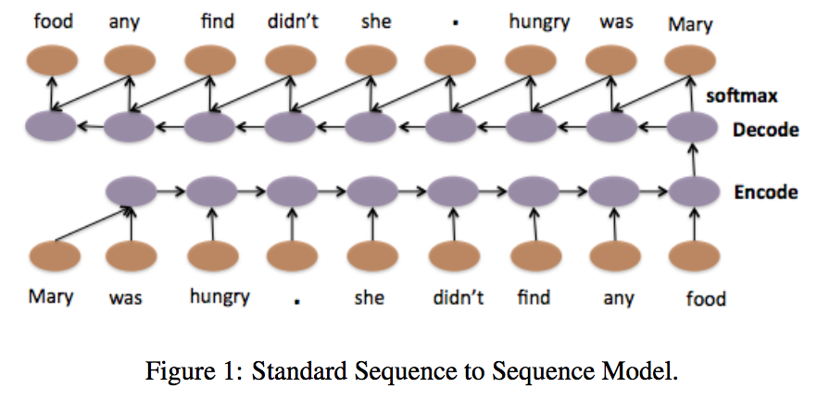
LSTM Encoder-Decoder Based Neural Machine Translation
Example:

Slide 22
An Issue with Encoder-Decoder Approach
Issue:
all the necessary information of a source sequence is compressed into a fixed-length vector.
Difficult to cope with long sequences
It is showed that performance of basic encoder–decoder deteriorates rapidly as the length of an input sentence increases [Cho, Kyunghyun, et al. "On the properties of neural machine translation: Encoder-decoder approaches." arXiv preprint arXiv:1409.1259 (2014)]
Solution: attention based model. Rather than compressing an entire sequence into a static representation, attention allows relevant features to dynamically come to the forefront as needed.

Slide 23
Attention Based Model
Solution: attention based model. Rather than compressing an entire sequence into a static representation, attention allows relevant features to dynamically come to the forefront as needed.
Each time the model generates an output, it (soft-)searches for a set of positions in an input where the most relevant information is concentrated.
The model then predicts an output based on the context vectors associated with these source positions and all the previous generated sequence

Slide 24
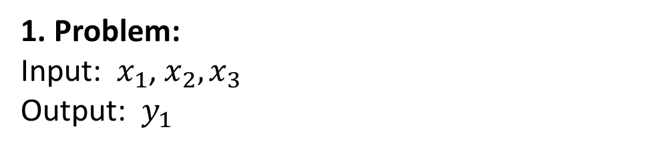
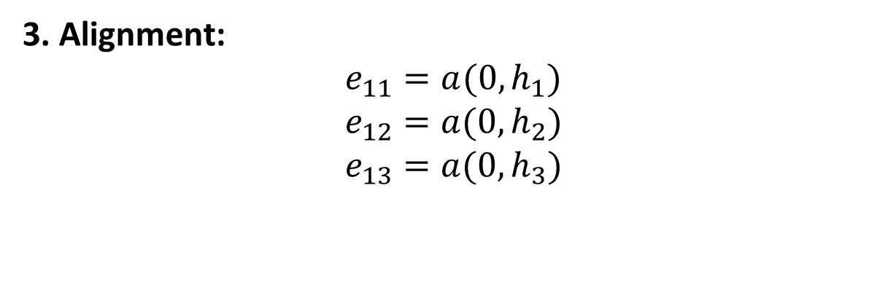
Attention Based Model: Example
1. Problem:
Input: $x_{1}$, $x_{2},x_{3}$
Output: $y_{1}$
2. Encoding:
Sequence-to-sequence encoding:
$$h_{1}=Encoder(x_{1}\text{, }x_{2},x_{3})$$
Attention based encoding:
$$h_{1},h_{2},h_{3}=Encoder(x_{1}\text{, }x_{2},x_{3})$$
3. Alignment:
$$e_{11}=a(0,h_{1})$$
$$e_{12}=a(0,h_{2})$$
$$e_{13}=a(0,h_{3})$$
The alignment model scores (e) how well each encoded input (h) matches the current output of the decoder (s).
For two decoder outputs

Slide 25
Attention Based Model: Example
1. Problem:
Input: $x_{1}$, $x_{2},x_{3}$
Output: $y_{1}$
2. Encoding:
Sequence-to-sequence encoding:
$$h_{1}=Encoder(x_{1}\text{, }x_{2},x_{3})$$
Attention based encoding:
$$h_{1},h_{2},h_{3}=Encoder(x_{1}\text{, }x_{2},x_{3})$$
3. Alignment:
$$e_{11}=a(0,h_{1})$$
$$e_{12}=a(0,h_{2})$$
$$e_{13}=a(0,h_{3})$$
We use two subscripts for these scores, e.g. e11 where the first “1” represents the output time step, and the second “1” represents the input time step.
For two decoder outputs

Slide 26
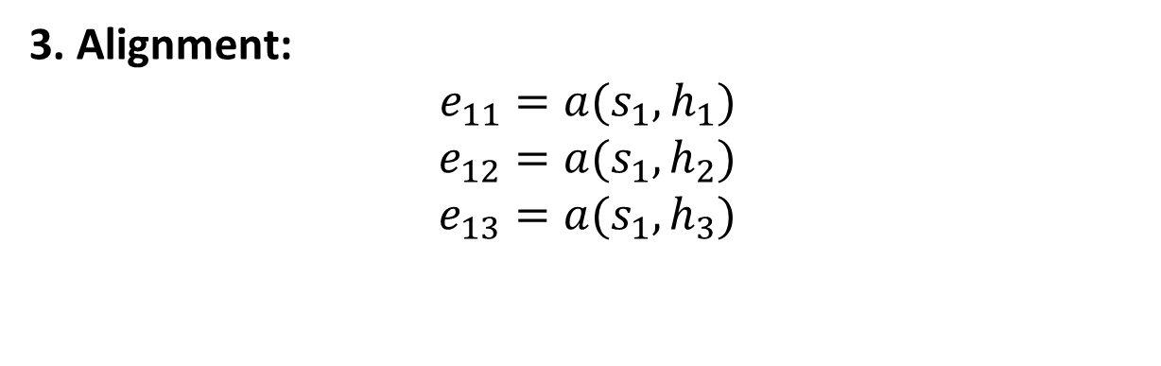
Attention Based Model: Example
1. Problem:
Input: $x_{1}$, $x_{2},x_{3}$
Output: $y_{1}$
2. Encoding:
Sequence-to-sequence encoding:
$$h_{1}=Encoder(x_{1}\text{, }x_{2},x_{3})$$
Attention based encoding:
$$h_{1},h_{2},h_{3}=Encoder(x_{1}\text{, }x_{2},x_{3})$$
3. Alignment:
$$e_{11}=a(s_{1},h_{1})$$
$$e_{12}=a(s_{1},h_{2})$$
$$e_{13}=a(s_{1},h_{3})$$
We use two subscripts for these scores, e.g. e11 where the first “1” represents the output time step, and the second “1” represents the input time step.
For two decoder outputs

Slide 27
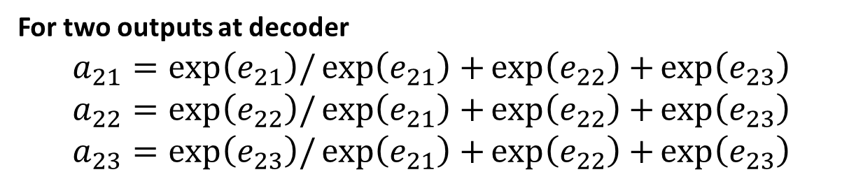
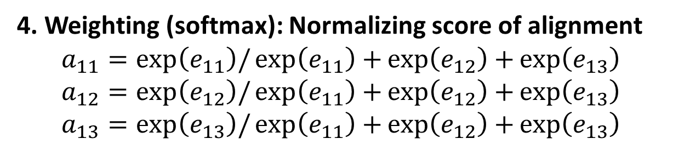
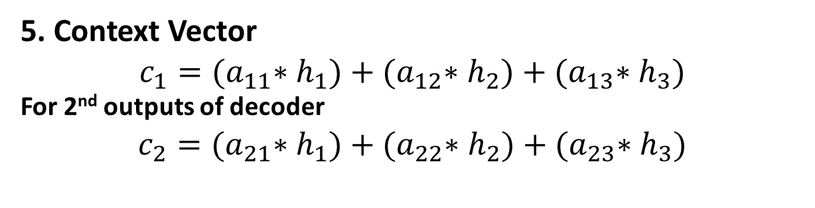
Attention Based Model: Example
4. Weighting (softmax): Normalizing score of alignment
$$a_{11}=\exp\left(e_{11}\right)/\exp\left(e_{11}\right)+\exp\left(e_{12}\right)+\exp\left(e_{13}\right)$$
$$a_{12}=\exp\left(e_{12}\right)/\exp\left(e_{11}\right)+\exp\left(e_{12}\right)+\exp\left(e_{13}\right)$$
$$a_{13}=\exp\left(e_{13}\right)/\exp\left(e_{11}\right)+\exp\left(e_{12}\right)+\exp\left(e_{13}\right)$$
For two outputs at decoder
$$a_{21}=\exp\left(e_{21}\right)/\exp\left(e_{21}\right)+\exp\left(e_{22}\right)+\exp\left(e_{23}\right)$$
$$a_{22}=\exp\left(e_{22}\right)/\exp\left(e_{21}\right)+\exp\left(e_{22}\right)+\exp\left(e_{23}\right)$$
$$a_{23}=\exp\left(e_{23}\right)/\exp\left(e_{21}\right)+\exp\left(e_{22}\right)+\exp\left(e_{23}\right)$$
5. Context Vector
$$c_{1}={(a}_{11}∗h_{1})+{(a}_{12}∗h_{2})+{(a}_{13}∗h_{3})$$
For 2nd outputs of decoder
$$c_{2}={(a}_{21}∗h_{1})+{(a}_{22}∗h_{2})+{(a}_{23}∗h_{3})$$

Slide 28
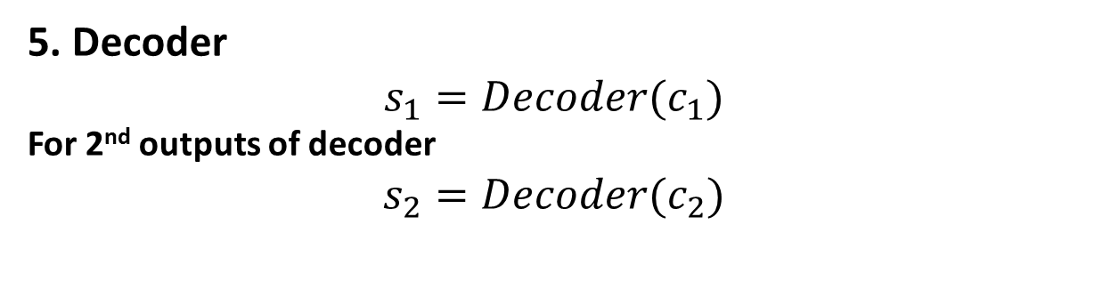
Attention Based Model: Example
5. Decoder
$$s_{1}=Decoder(c_{1})$$
For 2nd outputs of decoder
$$s_{2}=Decoder(c_{2})$$

Slide 29









Attention Based Model: Example
$$h_{1}$$
$$h_{2}$$
$$h_{3}$$
$$x_{1}$$
$$x_{2}$$
$$x_{3}$$
$$t_{1}$$
$$t_{2}$$
$$t_{3}$$

Slide 30




Attention Based Model: Example
$$a_{1}$$
$$a_{2}$$
$$a_{3}$$
$$h_{1}$$
$$h_{2}$$
$$h_{3}$$
$$0$$
$$x_{1}$$
$$x_{2}$$
$$x_{3}$$
$$t_{1}$$
$$t_{2}$$
$$t_{3}$$

Slide 31













Attention Based Model: Example
$$a_{1}$$
$$a_{2}$$
$$a_{3}$$
$$c_{1}$$
$$=$$
$$h_{1}$$
$$×$$
$$a_{1}$$
$$+$$
$$h_{1}$$
$$×$$
$$a_{1}$$
$$+$$
$$h_{1}$$
$$×$$
$$a_{1}$$
$$h_{1}$$
$$h_{2}$$
$$h_{3}$$
$$0$$
$$x_{1}$$
$$x_{2}$$
$$x_{3}$$
$$t_{1}$$
$$t_{2}$$
$$t_{3}$$

Slide 32


Attention Based Model: Example
$$a_{1}$$
$$a_{2}$$
$$a_{3}$$
$$c_{1}$$
$$=$$
$$h_{1}$$
$$×$$
$$a_{1}$$
$$+$$
$$h_{1}$$
$$×$$
$$a_{1}$$
$$+$$
$$h_{1}$$
$$×$$
$$a_{1}$$
$$h_{1}$$
$$h_{2}$$
$$h_{3}$$
$$s_{1}$$
$$0$$
$$c_{1}$$
$$x_{1}$$
$$x_{2}$$
$$x_{3}$$
$$t_{1}$$
$$t_{2}$$
$$t_{3}$$

Slide 33
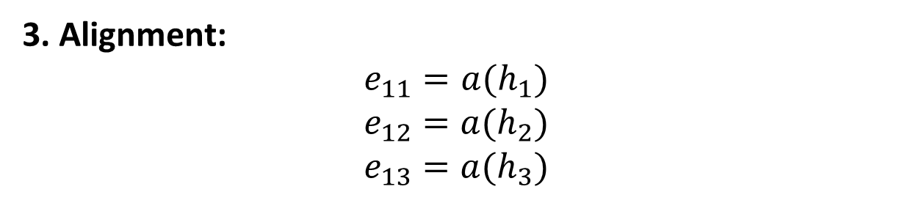
Variant of Attention Based Model
The hidden state from the last output time step (s(t-1)) is dropped from the scoring of annotations
3. Alignment:
$$e_{11}=a(h_{1})$$
$$e_{12}=a(h_{2})$$
$$e_{13}=a(h_{3})$$
Yang, Zichao, et al. "Hierarchical attention networks for document classification." Proceedings of the 2016 Conference of the North American Chapter of the Association for Computational Linguistics: Human Language Technologies. 2016.
Zhou, Peng, et al. "Attention-based bidirectional long short-term memory networks for relation classification." Proceedings of the 54th Annual Meeting of the Association for Computational Linguistics (Volume 2: Short Papers). Vol. 2. 2016.

Slide 34
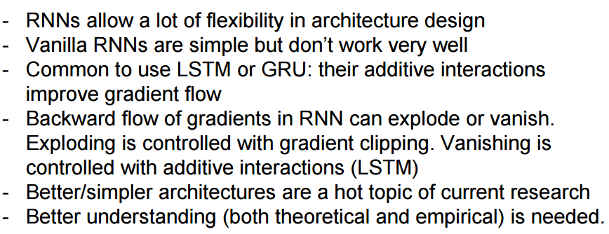
Summary

Slide 35
References
Hochreiter, S. and Schmidhuber, J., 1997. Long short-term memory. Neural computation, 9(8), pp.1735-1780.
Chung, J., Gulcehre, C., Cho, K. and Bengio, Y., 2014. Empirical evaluation of gated recurrent neural networks on sequence modeling. arXiv preprint arXiv:1412.3555.
Zilly, J.G., Srivastava, R.K., Koutník, J. and Schmidhuber, J., 2016. Recurrent highway networks. arXiv preprint arXiv:1607.03474.
Zia, T., 2018. Hierarchical recurrent highway networks. Pattern Recognition Letters.
Zia, T. and Razzaq, S., 2018. Residual Recurrent Highway Networks for Learning Deep Sequence Prediction Models. Journal of Grid Computing, pp.1-8.

